Slide 1
CTI League
Disinformation
2020-07-11
Data Science 4 Disinfo Response: Relationships as Data
Notes:
Welcome. This training is designed to frame a training route for people wanting to do tactical disinformation data science. Why this series? To:
Set the art for real-time disinformation data science
Train disinfo team in useful data science skills
Get feedback and new ideas on what we do
Practice SJ’s university course
So as always, all comments, corrections, additions welcomed. Released CC-by-SA: please use this work yourself, but please also attribute it back to the CogSecCollab.

Slide 2
Data Science 4 Disinformation Response series
TBA Introduction to the disinformation team
2020-05-06 What are we chasing? Digital harm training
TBA getting set up for disinformation data science
2020-05-27 Data sources (process, sources, stores)
2020-07-04 Disinfo Data Science examples
TBA Social text analysis
TBA Image data analysis
2020-07-11 Relationships as data
TBA Extending your analysis with machine learning skillz
TBA Communicating results (style, narratives, visualisations)
Notes:
AKA DS4DR

Slide 3
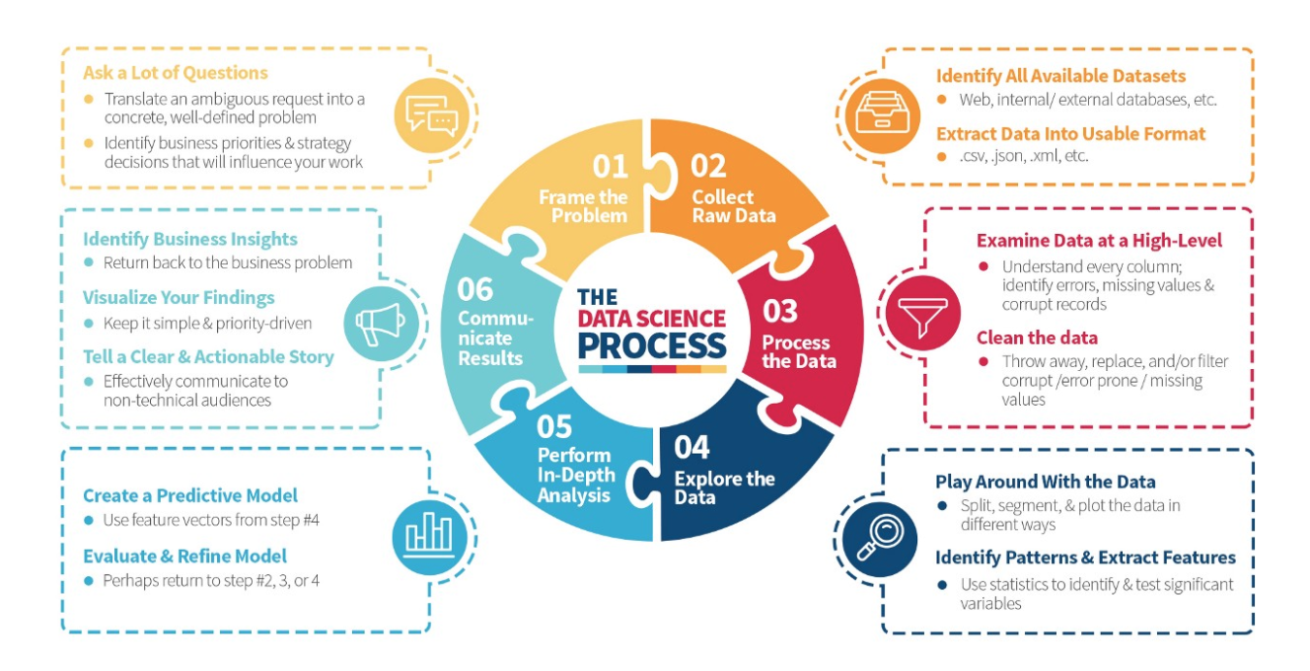
Recap: Data Science is a Process
https://medium.com/the-mission/deconstructing-data-science-breaking-the-complex-craft-into-its-simplest-parts-15b15420df21
Notes:
Read the blogpost btw - it’s a lovely description of what happens in data science.

Slide 4
Recap: (Some) Tactical Tasks
Credibility/ Verification
Fact-checking: verify article, image, video etc doesn’t contain disinformation.
Source-checking: verify source (publisher, domain etc) doesn’t distribute disinformation.
Network detection
Pinkslime finding: find inauthentic website networks
Network finding: find inauthentic account networks (including botnets)
Activity analysis
Detect computational amplification
Detect fake accounts
Look at patterns of account creation dates for popular messages
Detect, track and analyse narratives
Notes:
Fact-checking is hard, and usually needs a team of fact-checkers, up-to-date knowledge etc.
Source-checking: This is why we label and track URLs. Several groups already publish labelled lists of domains.
Source networks: Some work on “pink slime” exists.

Slide 5
Relationships are everywhere

Slide 6
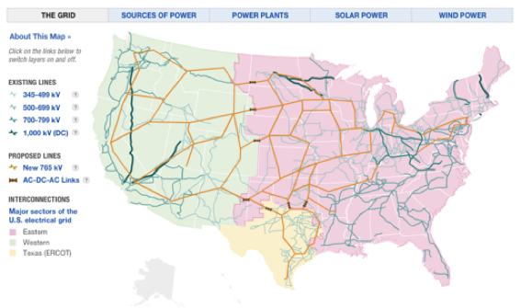
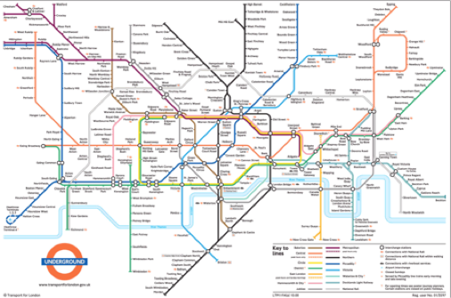
Infrastructure
Notes:
Let’s start with networks where there’s an obvious physical link. These include things like communications grids, power grids, and the movement of water supplies between streams, rivers, farms and processing plants.
As you look at these examples, I want you to think about the types of questions you could start asking with this network data. For example, in infrastructure, you often only have access to the junctions and the fact that there *is* a connection between two points. One question here might be “are there any critical links here”, e.g. if one link fails, could it break the grid, or stop an area being supplied with electricity? Image: the main power grid in the USA, from NPR: Visualising the US Power Grid
With transport, the dataset gets richer. You not only have the nodes and links between them, you also have timetables that list the average time between stations (and the current state of the network) and the switching costs of changing lines at a station (e.g. the time taken to walk between platforms). Image from Transport for London: London Underground Map
We’re infosec people - the obvious networks for us are things like internet backbones. Still networks. Still things we can reason about and apply math to.

Slide 7
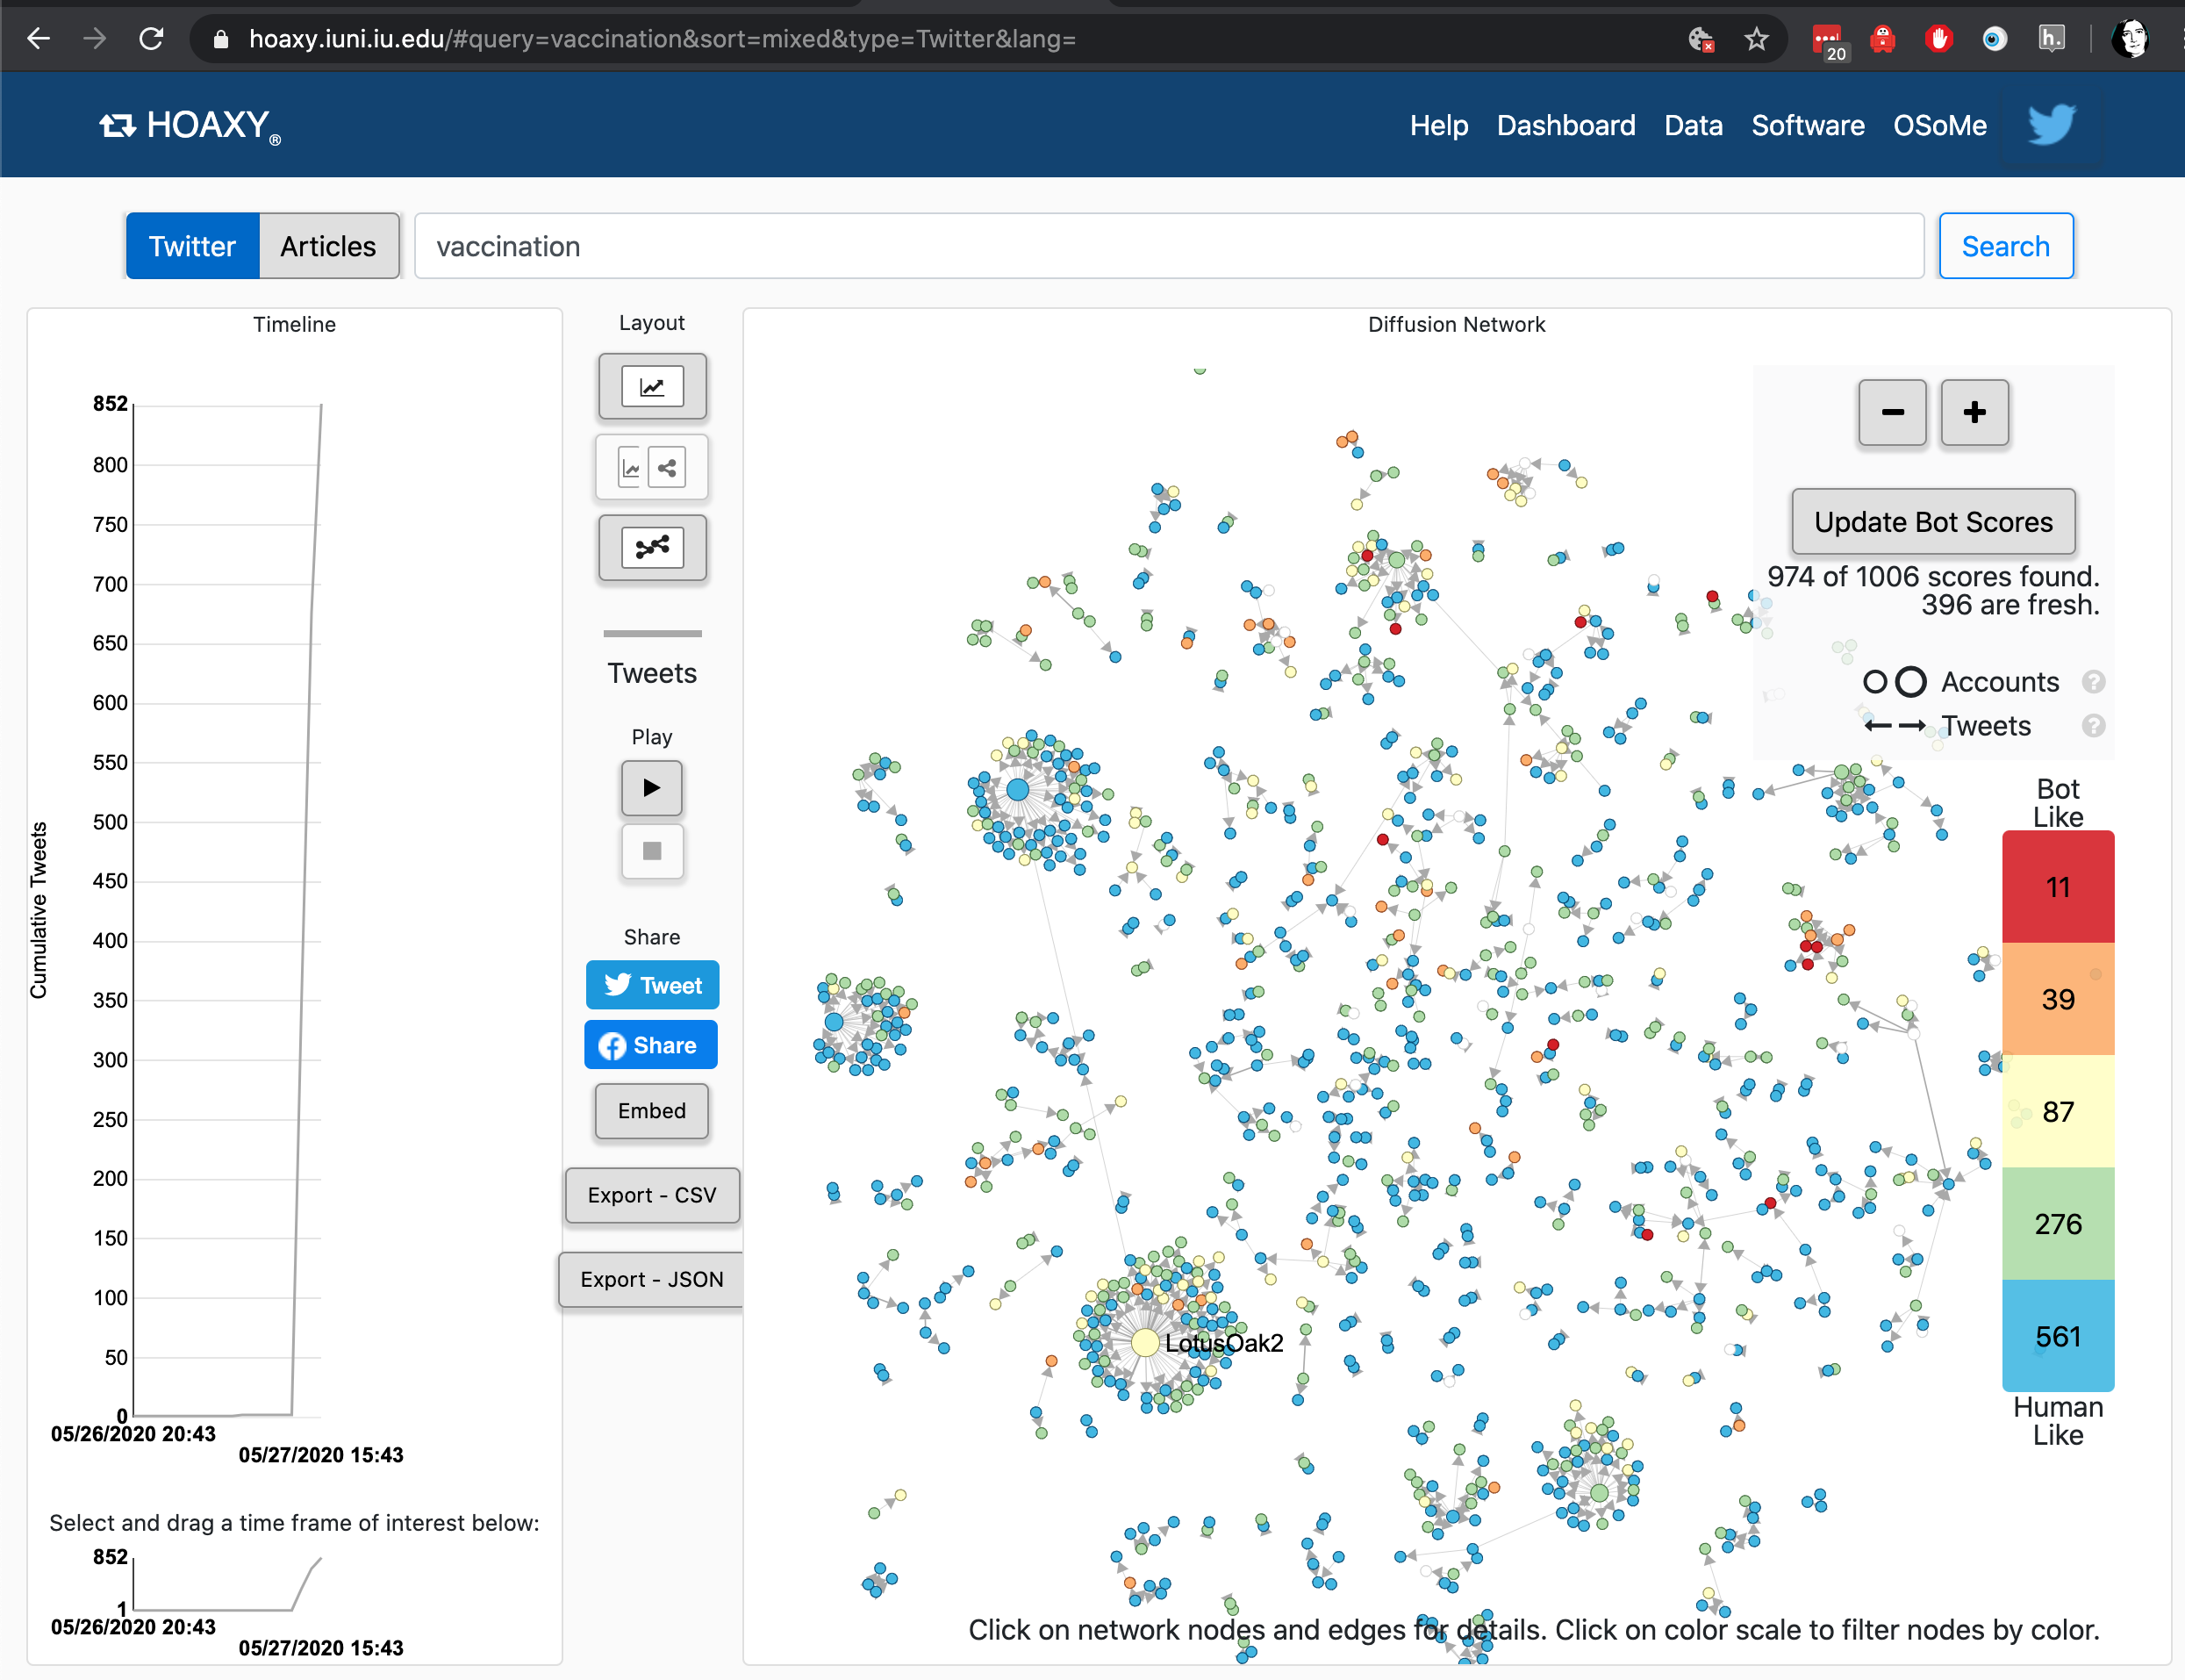
Social Media accounts
Notes:
UIndiana toolset (Hoaxy) https://hoaxy.iuni.iu.edu/#query=vaccination&sort=mixed&type=Twitter&lang= which uses Gephi to visualise Social Media networks.
We have instructions for how to run twitter through Gephi in the BigBook too.

Slide 8
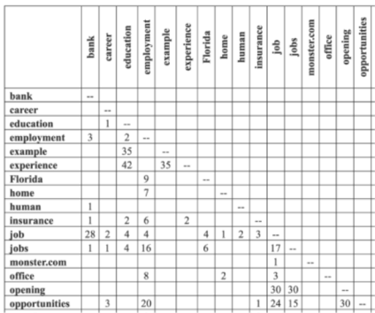
Word co-occurrence
Notes:
Much of text analysis can also be framed as networks. Here’s a matrix showing words that occur together in sentences and how many times they’ve co-occurred in the dataset. If we see every words as a node, and every nonzero co-occurrence score as a link, we’ve got ourselves a network. This can also be applied at the document level, e.g. Jonathan Stray’s Overview project analysed networks of documents to find civilian deaths in the Iraq War.
We could also use this on hashtags, e.g. build a network of the hashtags that are used together.
Image: (Wise blogpost on word co-occurance matrices)

Slide 9
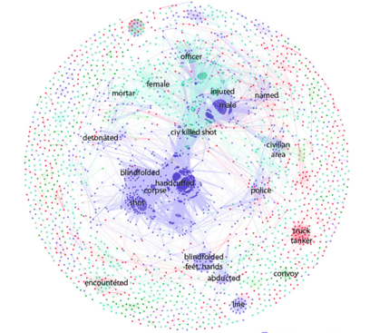
Document Similarity
Notes:
Image: http://jonathanstray.com/a-full-text-visualization-of-the-iraq-war-logs - colours are types of events being described.
Documents are often clustered using latent dirichlet methods; this is what was used on the Panama papers.

Slide 10

Image and video similarity
Notes:
Lots of ways to compare images
Getting label probabilities from something like Rekognition
Deep ranking e.g. https://medium.com/@akarshzingade/image-similarity-using-deep-ranking-c1bd83855978
But it can all be converted into networks in the end…

Slide 11
We already look at these relationships:
Social media accounts
Hashtags
URLs
Images
Text
Groups
...

Slide 12
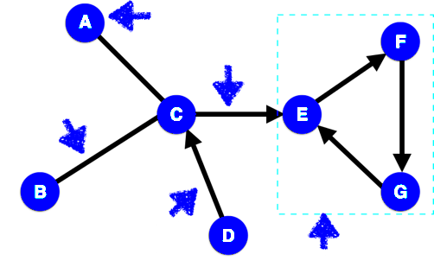
Today: Relationships as Networks
Notes:
We’re going to be dealing with simple networks. These each have features, that we need to be able to name.
Node: object in the network (e.g. two people)
Edge: link between two objects (e.g. a friendship)
Directed edge: link for a relationship that just goes one way (e.g. a ‘friends’ b, but b doesn’t ‘friend’ a).
Clique: set of nodes where every node in the clique is connected every other node in the clique.

Slide 13
Toolset

Slide 14
Common Tools
Standalone Tools:
Gephi
NodeXL
Cytoscape
(NetMiner)
D3.js
Python libraries:
NetworkX
Matplotlib
Notes:
Longer list: http://en.wikipedia.org/wiki/Social_network_analysis_software

Slide 15
Gephi
(https://gephi.org/users/download/)
Exploring networks

Slide 16
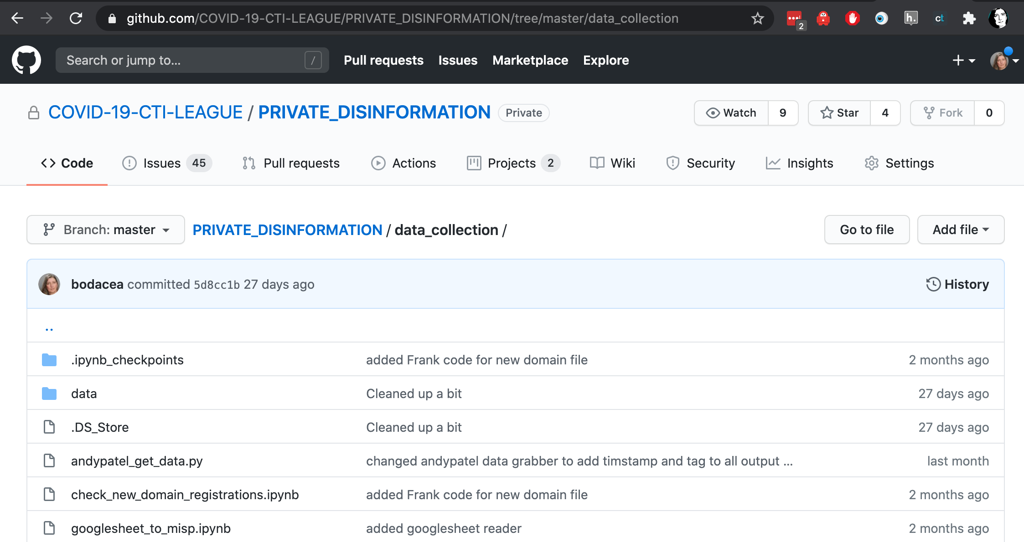
First, you’ll need some data…
Get file andypatel_get_data.py from
https://github.com/COVID-19-CTI-LEAGUE/PRIVATE_DISINFORMATION/tree/master/data_collection
In terminal window, type:
python andypatel_get_data.py ctileague
Notes:
https://github.com/COVID-19-CTI-LEAGUE/PRIVATE_DISINFORMATION/tree/master/data_collection
The filename? Because the code we based it on was from Andy Patel, @r0zetta, from FSecure - one of the disinformation data scientists you should be following if you’re interested in how this works.

Slide 17
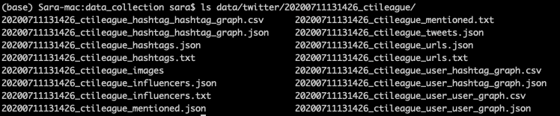
That created some Gephi input files…
User-user: counts replies, retweets, quotes, mentions
Hashtag-hashtag: counts co-occurrences
User-hashtag: counts hashtag use

Slide 18
Go Look at that with Gephi (from BigBook)
Start Gephi. Click on top menu>file>“import spreadsheet”. Grab User_user_graph.csv - use all defaults
Top menu: Go to data laboratory, “copy data to another column”, click ‘id’, click okay.
Go to overview. RHS: Run modularity algorithm, using defaults
RHS: Run average weighted degree algorithm
LHS: Click color icon, then partition, modularity class. Open palette, generate, unclick “limit number of colors”, preset=intense, generate, okay
LHS: Select “tt”, ranking, weighted degree, set minsize=0.2, choose 3rd spline, apply
LHS: Layout: OpenOrd, run. Then forceatlas2, run. Try stronger gravity, and scaling=200
Top menu: Preview - select “black background”, click “refresh”. Click “Reset zoom”
Notes:
Modularity: how strongly connected groups of nodes are. Highly modular graphs have really strongly connected cliques with weak connections between them. https://en.wikipedia.org/wiki/Modularity_(networks)
Degree: how many links each node has

Slide 19
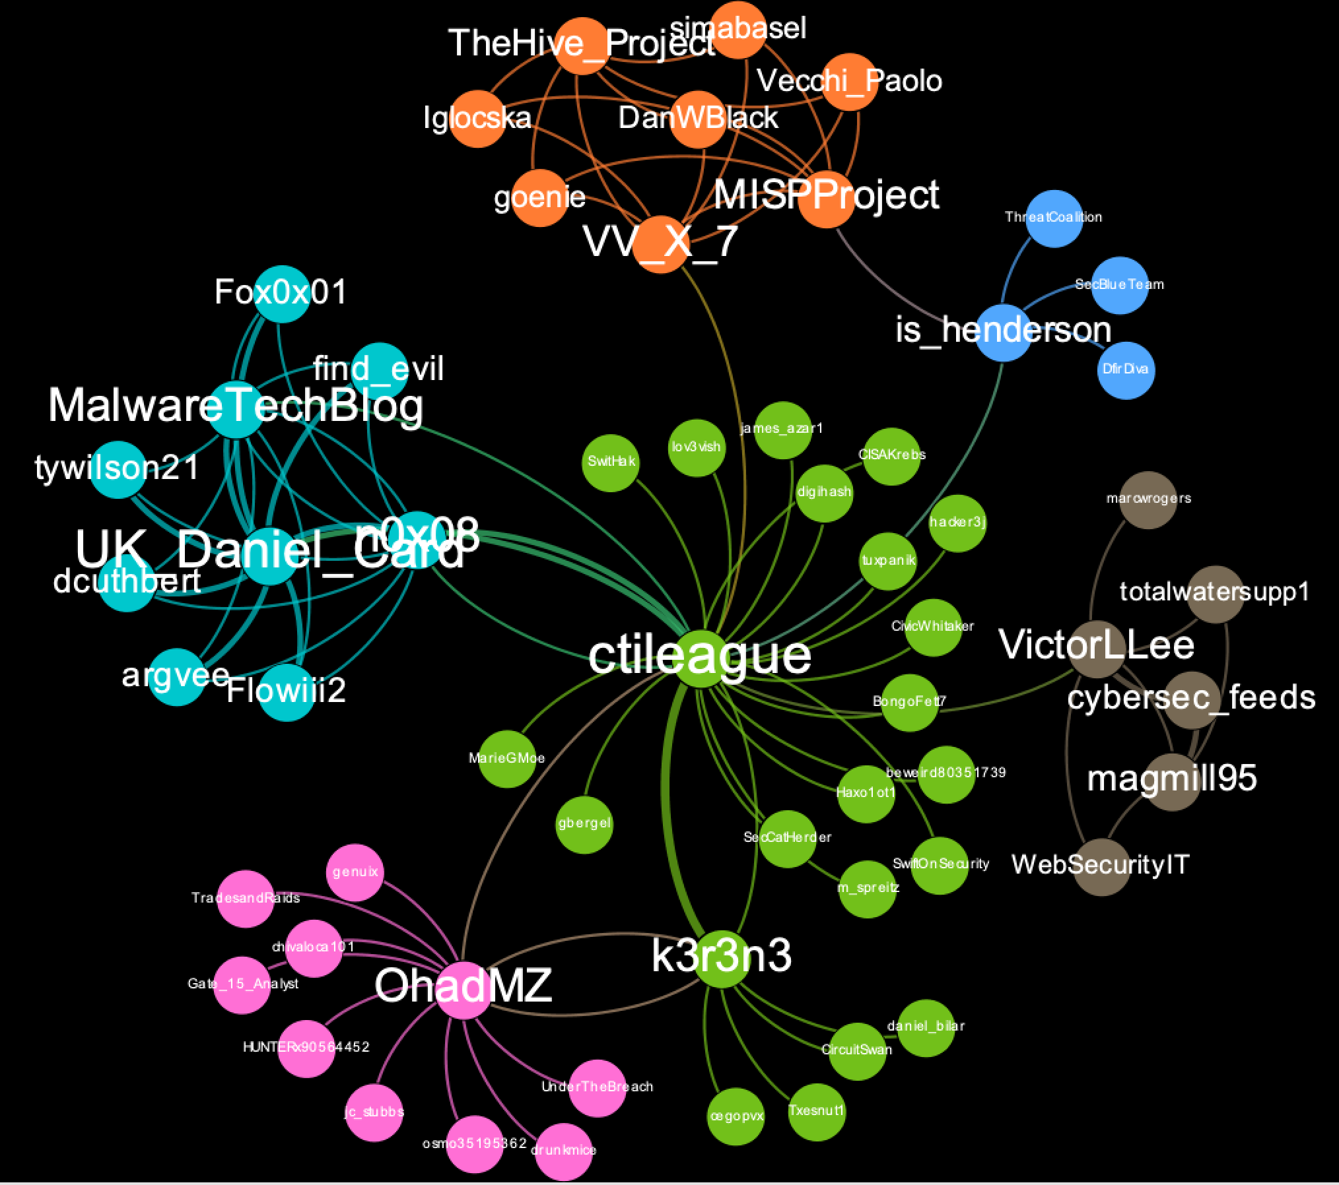
Erm… yeah… we don’t talk much?

Slide 20
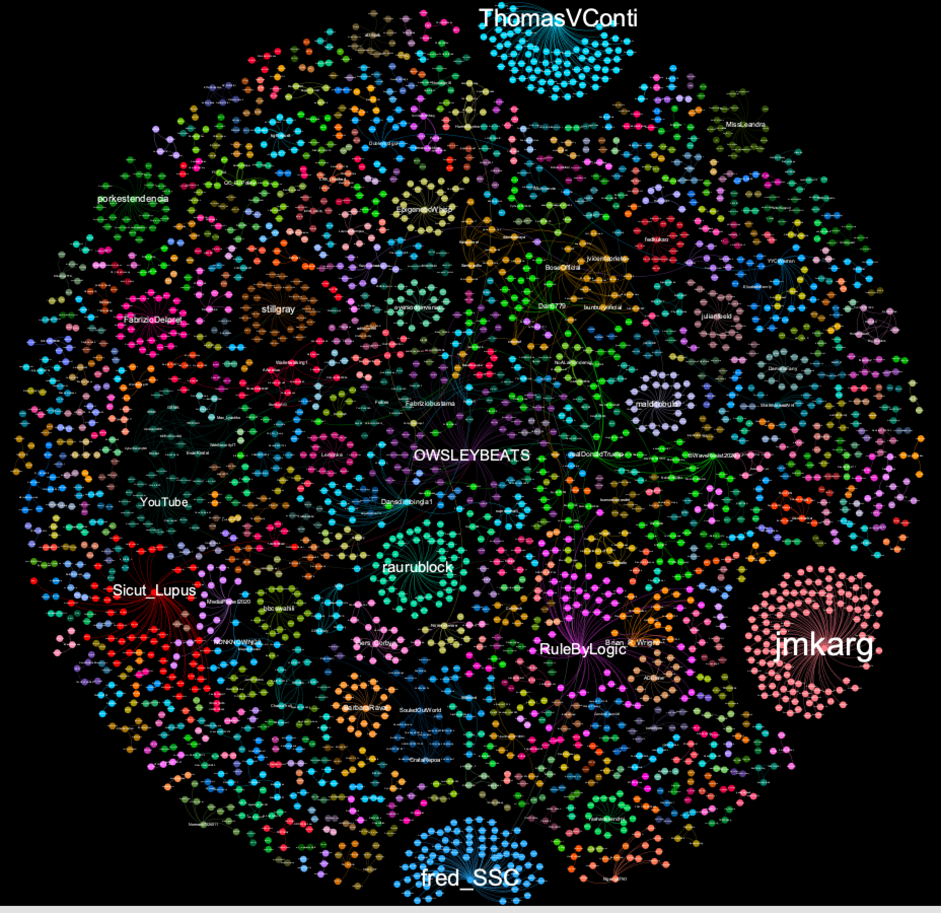
Covid-5G, on the other hand...
Notes:
Dataset grabbed from Twitter on 2020-07-11; datagrab stopped partway through (there’s a *lot* of it).

Slide 21
NetworkX
Understanding networks

Slide 22
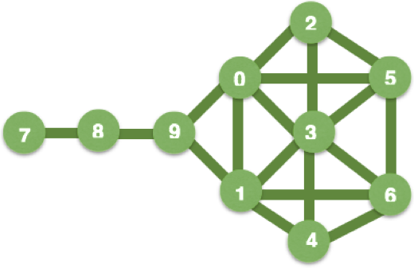
Network representation: diagram
Notes:
We’re going to look at the same network, using all the different ways that network tools could represent it. First up: a diagram, basically a visualisation of all the network’s node and links. Diagrams are good for explaining a network (and can be interactive)

Slide 23
Representation: adjacency matrix
[[ 0, 1, 1, 1, 0, 0, 0, 0, 0, 1],
[ 1, 0, 0, 1, 1, 0, 1, 0, 0, 1],
[ 1, 0, 0, 1, 0, 1, 0, 0, 0, 0],
[ 1, 1, 1, 0, 1, 1, 1, 0, 0, 0],
[ 0, 1, 0, 1, 0, 0, 1, 0, 0, 0],
[ 0, 0, 1, 1, 0, 0, 1, 0, 0, 0],
[ 0, 1, 0, 1, 1, 1, 0, 0, 0, 0],
[ 0, 0, 0, 0, 0, 0, 0, 0, 1, 0],
[ 0, 0, 0, 0, 0, 0, 0, 1, 0, 1],
1, 1, 0, 0, 0, 0, 0, 0, 1, 0]]
Notes:
An adjacency matrix is an n by n grid, with 1 row and 1 column for each network node, a “1” everywhere a link exists, and a ‘0’ everywhere else. Adjacency matrices are good for representing dense graphs (i.e. graphs with lots of links between nodes).
You can also represent ‘sparse’ graphs using an adjacency matrix, but these will have lots and lots of zeros in them. The Python scipy.sparse library is useful is you want to represent very large sparse matrices, without taking up huge amounts of memory.

Slide 24
Representation: Adjacency List
{0: [1, 2, 3, 9],
1: [0, 9, 3, 4, 6],
2: [0, 3, 5],
3: [0, 1, 2, 4, 5, 6],
4: [1, 3, 6],
5: [2, 3, 6],
6: [1, 3, 4, 5],
7: [8],
8: [9, 7],
9: [8, 1, 0]}
Notes:
An adjacency list is a list of a the nodes, with a list of all the nodes connected to each of them.
An adjacency list is good for representing sparse graphs (e.g. social networks tend to be sparse), and is the main network representation used by NetworkX.

Slide 25
Representation: Edge List
{(0,1), (0,2), (0,3), (0,9),
(1,3), (1,4), (1,6), (1,9),
(2,3), (2,5), (3,4), (3,5), (3,6),
(4,6), (5,6), (7,8), (8,9)}
Notes:
An edge list is a list of all the connections between nodes. This is a good general network representation.
You’ll also find networks described in mathematical terms, e.g. as “G = (V,E,e)” where G is the network (‘graph’), V are the nodes (‘vertices’); E are the edges and e is the relationship (‘mapping’) between edges and nodes. Networks are covered by areas of maths that include Graph Theory.

Slide 26
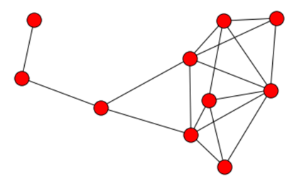
Getting graphs into NetworkX
import networkx as nx
edgelist = {(0,1), (0,2), (0,3), (0,5), (0,9), (1,3), (1,4), (1,6), (1,9), (2,3), (2,5), (3,4), (3,5), (3,6), (4,6), (5,6), (7,8), (8,9)}
G = nx.Graph()
for edge in edgelist:
G.add_edge(edge[0], edge[1])
Notes:
So let’s try some of this. NetworkX produces ugly graphs, but has a good set of network analysis tools.
(NB if you want a directed graph, use nx.DiGraph() )
… and now you can do G.nodes and G.edges to see what’s in your graph
NB NetworkX has visualisations: import matplotlib, and use nx.draw(G) to see them. They’re not pretty: when humans draw graphs, they generally think about where to put the nodes, minimise the number of links crossing over each other, make them pretty. Computers don’t think that way, so don’t be surprised if NetworkX draws something that doesn’t look, on the surface, anything like your graph. “Making it pretty” is one of the reasons that we use packages like Gephi to visualise graphs (another is “make it easier to spot patterns in this graph”).

Slide 27
Basic Network Analysis
Centrality: how important is each node to the network?
Community detection: what type of groups are there in this network?
Transmission: how might (information, disease, etc) move across this network?
Network characteristics: what type of network do we have here?
Notes:
We care about all of these in disinfo.

Slide 28
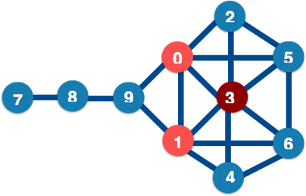
Degree Centrality: who has lots of friends?
nx.degree_centrality(G)
3 0.666
0 0.555
1 0.555
5 0.444
6 0.444
2 0.333
4 0.333
9 0.333
8 0.222
7 0.111
Notes:
Centrality is all about power. And there are different types of power. The simplest form of centrality is degree centrality, e.g. how many links connect directly to each node.
NetworkX centrality functions are here: http://networkx.lanl.gov/reference/algorithms.centrality.html Note that degree centrality is normalized (divided) by the largest possible number of connections per node: in this case, 9.
Degree centrality is not a great measure of power: a more important measures may be the number of nodes that each node can easily reach, and it’s possible that the highest-ranked node by degree centrality is part of a clique that’s not well connected to the outside world.

Slide 29
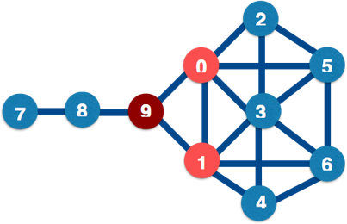
Betweenness Centrality: who are the bridges?
nx.betweenness_centrality(G)
9 0.38
0 0.23
1 0.23
8 0.22
3 0.10
5 0.02
6 0.02
2 0.00
4 0.00
7 0.00
Notes:
Between = how many nodes are there between two nodes?
Nodes with high betweenness have influence over the flow of information or goods through a network: they bridge separate communities (good) but also often are a single point of failure in communications between those communities (bad).
Betweenness = (number of shortest paths including n / total number of shortest paths) / number of pairs of nodes

Slide 30
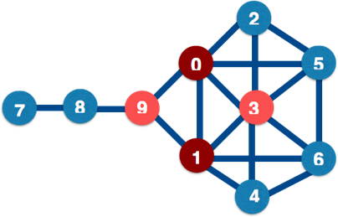
Closeness centrality: who are the hubs?
nx.closeness_centrality(G)
0 0.64
1 0.64
3 0.60
9 0.60
5 0.52
6 0.52
2 0.50
4 0.50
8 0.42
7 0.31
Notes:
Closeness = has the shortest average path to all other nodes in the network. Nodes with high closeness have great influence over the rest of the network, especially if influence diminishes with path length; these points are also good places to observe all information flows from.
Closeness = sum(distance to each other node) / (number of nodes-1)

Slide 31
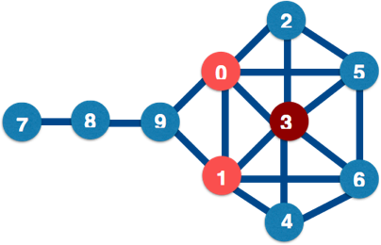
Eigenvalue centrality: who has most influence?
nx.eigenvector_centrality(G)
3 0.48
0 0.39
1 0.39
5 0.35
6 0.35
2 0.28
4 0.28
9 0.19
8 0.04
7 0.01
Notes:
Eigenvector centrality measures how much influence a node has in the whole network, taking account of their connections to other highly-connected nodes. These are the “kings” of your network - they might not have great closeness or betweenness, but they do wield a lot of influence. The algorithm behind Google search, PageRank, is based on eigenvector centrality.
NB Eigenvector centrality algorithms are complex, and won’t always give you a solution.

Slide 32
Communities
Communities = groupings within your network.
Useful for questions like
“how is a network likely to split into groups” and
“how do I efficiently influence this network”.
Note that when we have a community, we can study it as a network in its own right, including finding the most important nodes in it.
Notes:
“Small world theory” = there are roughly 6 steps on the shortest path between each pair of nodes in the world (see also “6 degrees of Kevin Bacon” http://en.wikipedia.org/wiki/Six_degrees_of_separation). The maths works out at roughly s = ln(n)/ln(k) where n is the population size and k is the average number of connections per node. For k=30, s is usually roughly 6.
NetworkX community functions: http://networkx.lanl.gov/reference/algorithms.community.html

Slide 33
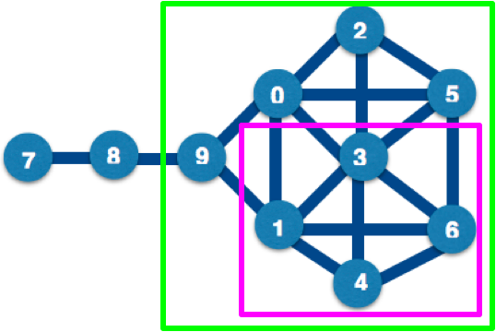
Communities: Cliques and Cores
nx.find_cliques(G)
nx.k_clique_communities(G, 2)
Notes:
These are group measures based on the numbers of links. The K-core is defined as: Every node in the clique is connected to K or more other nodes in the clique.
Clique-level analysis and node-level analysis interact with each other, e.g. if you find a set of cliques in a network, you can then look for and use the central nodes in those cliques.
In this graph, the largest cliques have 4 nodes in them: for instance, the nodes in the pink box are all connected to each other. There are two 4-cliques in this diagram ([[0,2,3,5],[1,3,4,6]]), two 3-cliques: [[0,1,3],[0,1,9]], and two 2-cliques: [[7,8],[8,9]]. The largest k-cores is a 2-core, with the green box around it: [0,1,2,3,4,5,6,9].
K-cores and cliques don’t always find the natural cliques in a graph (especially one containing human relationship). N-cliques: “friend of friend” cliques; use Bron and Kerbosch algorithm. Issues include nodes that contribute to the clique aren’t included in it. P-clique addresses some of this. Other approaches: n-clans, k-plexes etc.: see http://faculty.ucr.edu/~hanneman/nettext/C11_Cliques.html#nclique

Slide 34
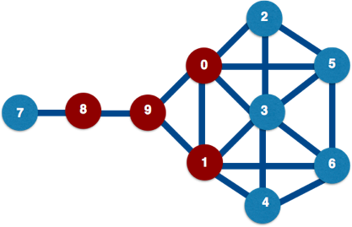
Simple contagion: always transmit
Notes:
Simple contagion (aka diffusion) models are used when it’s important that you find *everybody* in contact, e.g. for Ebola, you have to assume that everyone an infectious person is in contact with is a potential carrier. Here, we assume that node 9 changes state first; in the next step of the algorithm, the nodes directly connected to it (0,1,7) change state; in the next step, the nodes connected to (0,1,7) change state, etc. etc.
Thought experiment: infections are time-sensitive, e.g. you get infected, then either get better or die. How would you represent this in a network? What would you expect to happen in a small-world network?

Slide 35
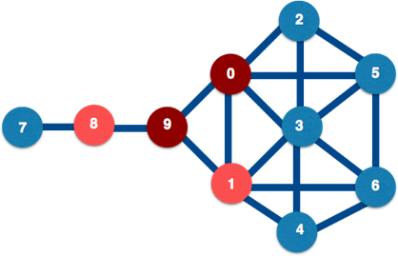
Complex contagion: only transmit sometimes
Notes:
Complex contagion are diffusion models for more complex choices, e.g. whether to go see a movie, based on your friends’ opinions plus reading movie reviews.
In complex contagion, a node changes state based on the state of *all* its neighbors, and often also on outside information; just because 9 is in one state, 1 doesn’t have to change to that state too (but it might change state with probability p).

Slide 36
Network-level Properties
Characteristic path length: average shortest distance between all pairs of nodes
Clustering coefficient: how likely a network is to contain highly-connected groups
Degree distribution: histogram of node degrees
Disconnection
(Ask Pablo about scale-free networks)
Notes:
Social networks = short path lengths, high clustering, skewed degree distributions.
Small worlds = lots of highly-connected small groups with fewer connections to other groups: Saw this effect in the Ebola response contact-tracking.
All available in networkx
Disconnected networks are networks where there isn’t a path from every node to every other node in the network. These networks can be interesting because of the lack of connections between groups (e.g. you’re trying to most efficiently connect up different transport systems). These can be described by their “components”, e.g.
Connected component = every node in the component can be reached from every other node
Giant component = connected component that covers most of the network

Slide 37
D3.js
Visualising networks

Slide 38
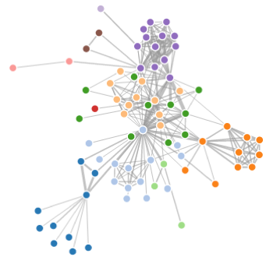
Force-directed visualisation
Notes:
Node-link diagrams are still the best way to describe networks. Most of the network tools will produce one of these. This is a D3 force-directed visualisation (bl.ocks.org/mbostock/4062045 : Les Miserables character relationships). Force-directed graphs try to produce a clean network visualisation by treating the network as though the nodes are pulling outwards with the links pulling them back; Gephi is also good for these.
Explaining graphs to the C-suite? Use visual cues they’re used to. Carefully. Some examples are in the Visualisation Periodic Table at http://www.visual-literacy.org/periodic_table/periodic_table.html

Slide 39
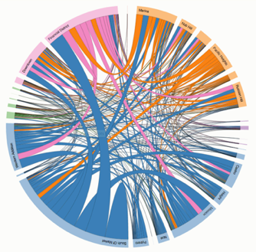
Edge Bundling (“Chord Diagrams”)
Notes:
Edge bundling is useful for small world networks. This is another d3 diagram (http://bost.ocks.org/mike/uberdata/ : Uber rides by neighbourhood); another D3 example is here: http://bl.ocks.org/mbostock/7607999

Slide 40
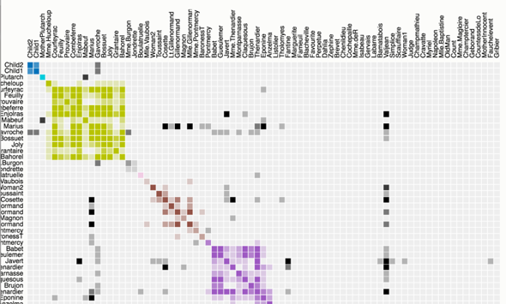
Adjacency Matrix
Notes:
An adjacency matrix can help if it’s nicely grouped, but sometimes it’s just more confusing. Metanodes (a network where each node is a group of smaller nodes) are useful for large networks of communities.
Image: https://bost.ocks.org/mike/miserables/
A heavy but useful post on network visualisation is http://www.cmu.edu/joss/content/articles/volume14/ChuWipfliValente.pdf

Slide 41
Other things to look at….
Overlapping community detection (modularity etc)
Homophily (how node dissimilarity affects networks)
Graph cohesion (which nodes strengthen or weaken a network)
Graph skeletons (e.g. minimum spanning trees)
Marketing metrics (reach etc)
Notes:
Classic modularity algs: https://www.cs.cmu.edu/~ckingsf/bioinfo-lectures/modularity.pdf

Slide 42
Over to You…

